Slide 1
Certification Prep Course - Foundations of IBM Cloud V2
Exam C1000-083
Section 2 - IBM Cloud Compute Options
IBM Cloud
Hybrid, multi-cloud by design.
Designed for your data.
AI Ready.
Secure to the Core.

Slide 2
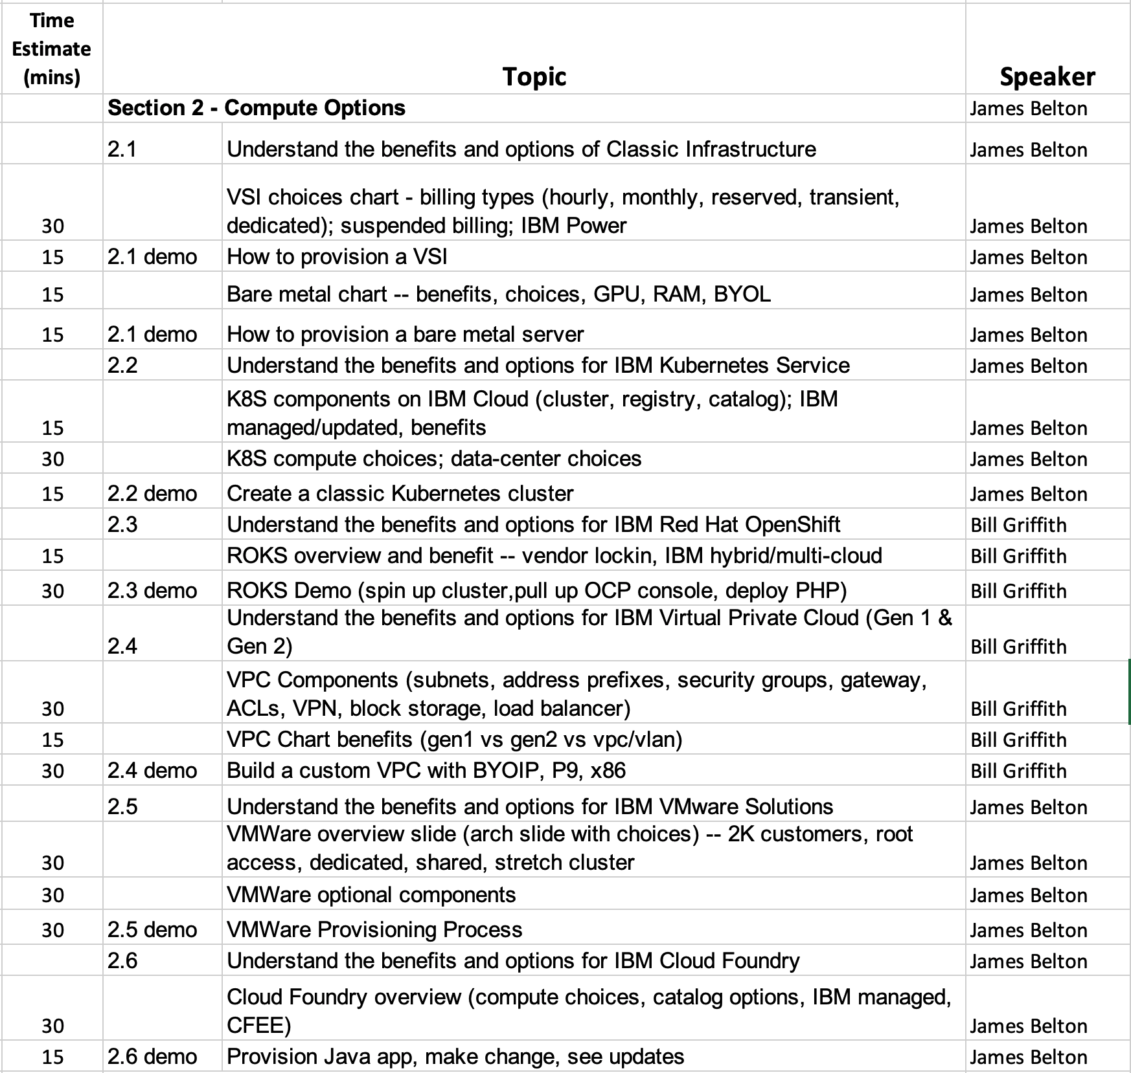
Agenda

Slide 3
IBM Cloud Infrastructure Services Portfolio
IBM Cloud Shared Services
Monitoring | Logging | Billing | Portal | IAM | Key Management | Certificate Management
Infrastructure Services
Cloud Native
Enterprise IT
VPC
Infrastructure
x86 Bare Metal Infrastructure
Power
Infrastructure Linux, AIX, IBM i
Z
Infrastructure Linux, z/OS
Interconnect Services
secure simple connectivity between runtime environments and to IBM’s full catalogue of cloud services
Edge Services
secure and accelerate application and content delivery
IBM Cloud / © 2019 IBM Corporation

Slide 4
Section 2.1 – Understand the benefits and options of Classic Infrastructure
Virtual Server Instance
IBM Virtual Servers - https://cloud.ibm.com/docs/vsi?topic=virtual-servers-about-virtual-servers
IBM Virtual Servers on Power - https://cloud.ibm.com/docs/infrastructure/power-iaas?topic=power-iaas-about-virtual-server
HyperProtect Virtual Servers - https://cloud.ibm.com/docs/services/hp-virtual-servers?topic=hp-virtual-servers-getting-started
VSI Types
Public - https://cloud.ibm.com/docs/vsi?topic=virtual-servers-about-public-virtual-servers
Dedicated - https://cloud.ibm.com/docs/vsi?topic=virtual-servers-dedicated-virtual-servers
Transient - https://cloud.ibm.com/docs/vsi?topic=virtual-servers-about-vs-transient
Reserved - https://cloud.ibm.com/docs/vsi?topic=virtual-servers-about-reserved-virtual-servers
VSI Benefits
Cost differences
Performance options
Security choices
Operating system choices
Billing choices
https://cloud.ibm.com/docs/vsi?topic=virtual-servers-about-virtual-servers

Slide 5

IBM Cloud offers multiple options for virtual server options
IBM Cloud Virtual Servers | IBM Cloud Power Virtual Servers | IBM Cloud Hyper Protect Virtual Servers
Customer-managed, highly customizable x86-based VMs or p9-based VMs on IBM Cloud | Customer-managed AIX and IBM i Power VM-based LPAR-as-a-Service on IBM Cloud | Industry’s first and only option for highly secure, customer-managed LinuxONE-based virtual servers in the cloud
Notes:
When compared to other offerings within IBM Cloud’s portfolio of virtual servers or IaaS, the differentiator for IBM Cloud Hyper Protect Virtual Servers is the underlying infrastructure: IBM LinuxONE. LinuxONE is the industry’s most secure Linux-based enterprise server providing top level security through tamper resistant FIPS-Level 4 -2 certified HSMs for key encryption as well as Secure Service Container technology to completely isolate workloads and cut off any admin access to customer data. This offering brings the security and reliability of the LinuxONE platform to the IBM Cloud.
This is proven, state-of-the-art technology that is new to the cloud. Its trusted level of services are especially attractive to banks and insurance companies that need these same qualities of service.
Faster data serving *
1.5x - 2.8x better throughput (Java, Node, PostgreSQL, MongoDB)
7x faster encryption
Ability to scale to 1,344 concurrent databases executing 377B transactions/day and <1ms response time
Scale a single MongoDB to 17TB with no sharding
Enabling a cloud computing model should be an imperative for your business. If you use a public cloud as a component in your cloud strategy, you should absolutely choose the IBM public cloud. While there are a multitude of really important reasons and benefits for this, we don’t have time to cover all of that today. What I would like to discuss is how IBM has uniquely and innovatively addressed many of security and data protection concerns with moving important applications and business processes into the public cloud.
These are some of the questions in our customer’s minds when they contemplate moving sensitive data and/or workloads to the public cloud.
Is my data and my customers’ data safe in the Cloud?
How can I meet data compliance requirements?
How can I ensure that my Cloud provider has no access to my data?
What solution can I consistently use to protect my data across all cloud apps?
What can I do to protect my data from internal and external threats?
How do isolate certain applications so that systems administrators can’t get access to sensitive data or application code?
How do I restrict my cloud provider from accessing my data or encryption safeguards?
From our perspective there are certain critical things at stake, if these questions are not intelligently and effectively addressed by your public cloud provider.
So let me tell you what IBM is doing to address these customer needs. We have four distinct solutions announced or in development and I want to not only explain them, but give you an opportunity to try them and be part of launching exciting, and innovative offerings that will dramatically improve the safety, security and data protection within public clouds.

Slide 6
Virtual Server Flavours Explained

Slide 7
Virtual Servers come in the following flavours:
- Public
- Dedicated
-Transient
-Reserved

Slide 8
Virtual Server Commonalities:
- Available Globally (50 + DCs)
- Up to 64 vCPUs / 512 GB RAM
-Network Performance of 1 Gbps on Public and Private networks
- Up to 5 SAN Volumes (or 5 local disks on Dedicated VS)

Slide 9
What is a Public Virtual Server?
- A Virtual Server that resides on shared (multi-tenant) hardware
- Rapidly scalable
- Hourly or Monthly billing

Slide 10
What is a Dedicated Virtual Server?
- A Virtual Server that resides on dedicated (single-tenant) hardware
- For compliance, security, performance
- Hourly or Monthly billing

Slide 11
What is a Transient Virtual Server?
- A Virtual Server that resides on shared (multi-tenant) hardware
- Uses ‘spare’ capacity in a Cloud Data Centre
- Fraction of the cost of standard Public VS
- Great for flexible workloads
- Per hour billing
- Automatically deprovisioned when capacity needed

Slide 12
What is a Reserved Virtual Server?
- A Virtual Server that resides on shared (multi-tenant) hardware
- Reserving capacity for a 1 or 3 year term
- Great for long lasting workloads
- Deep discounts due to commitment
- Hourly or Monthly billing

Slide 13
Reserved Virtual Servers – a closer look
- Reserve a capacity ‘block’ of CPU and RAM
- Create your Virtual Servers in that capacity (up to 20 per block)
- Reserved capacity is billed monthly
- Choose whether other options (storage, software, networking) are billed hourly or monthly

Slide 14
Section 2.1 – Understand the benefits and options of Classic Infrastructure
Bare Metal Servers
Your Bare Metal Servers is an hourly or monthly, single-tenant server that is dedicated to you; it is not shared in any part, including server resources, with other customers. You manage your server, which is provisioned without a hypervisor, and deployed in one or more data centers. Multiple Bare Metal Servers can communicate on the IBM Cloud virtual private network as if stationed on the same rack.
Bare Metal Server choices
Bare Metal Benefits
Bare Metal Billing Options
https://cloud.ibm.com/docs/bare-metal?topic=bare-metal-about-bm

Slide 15
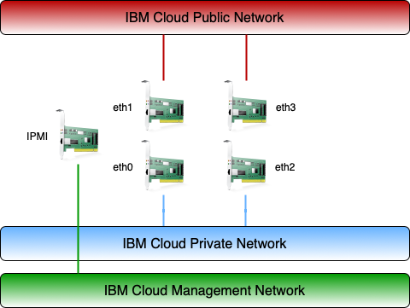
Bare Metal Network Deployment
Bare metal servers are deployed with a maximum of:
Two 10Gbe NICs connected to the public network.
Two 10Gbe NICs connected to the private network.
The server’s IPMI port is connected to the Management network which is reachable from the private network.
Bare Metal servers can be provisioned as “private network only”. The NICs in the server and the switch ports are disabled in the provisioning process,

Slide 16
Bare Metal Servers

Slide 17
Bare Metal Servers:
- What they are
- Comparison to Virtual Machines
-Use Cases
-Provisioning

Slide 18
What is a Bare Metal Server?
- A dedicated server which is yours to use and manage from the ‘metal up’
- Choice of pre-installed OS or none
- Preconfigured options or custom
- Certified for SAP workloads

Slide 19
Main Comparisons to a Virtual Machine
- No sharing of underlying hardware
- Manage the entire server
- Longer provisioning times

Slide 20
Example Bare Metal Server Use-Cases
- Software licensing
- Running compute-intensive workloads
- Workloads which need complete control, flexibility and security

Slide 21
Provisioning Bare Metal Servers
- Via the Catalog
- Hourly or Monthly
-Choose between pre-configured options or customise
-Choice of Operating system (or none)

Slide 22

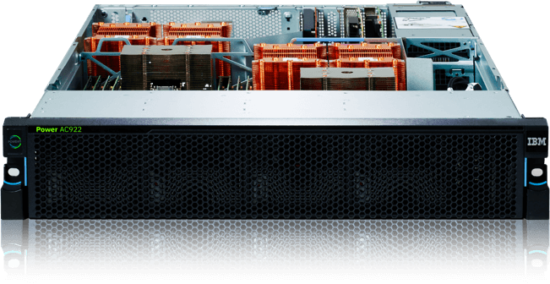
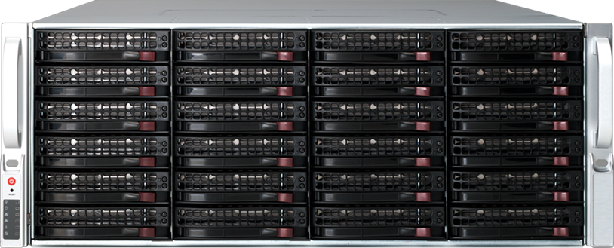

What’s New IBM Cloud Compute
Bare Metal Servers GDPR compliance HPC E2E encryption NVIDIA V100 GPUs MSSQL for Linux Intel Cascade Lake Intel E3 1270 with SGX 2nd Gen AMD EPYC | Virtual Servers Gen2 VPC x86, POWER 9 HyperProtect Servers (zVSI) Up to 100 Gbps networking BYOL (OS) Suspended billing, reserved instances, spot pricing 25% price reductions | VMWare Multi-tentant vCloud Director MZR stretch clusters with 99.99% SLA (100+ HW options) KYOK, HyTrust, Intel TXT vSphere 6.5u3 or 6.7u2 NSX-V, NSX-T, HCX, SSD VSAN BYOL, ESXi Root vRealize Operations | Certified SAP Servers Dual socket SMC Skylake for SAP HANA certification Dual socket SMC Skylake for SAP Netweaver certification SAP certified VMWare SAP certified on AIX (roadmap)
IBM Cloud/ © 2018 IBM Corporation
Notes:
Optional drive upgrades can be taken on most devices and fall into three categories. Each drive type offers a different benefit to users, so knowing their strengths and referring to use cases helps to steer customers in the right direction.
SSDs (solid state drive) provide high performance, low latency, and enterprise-class storage and are ideal for data-intensive applications.
SAS (serial attached SCSI) drives are a reliable, high speed option that are ideal for game, database, streaming media, and mission-critical servers.
SATA (serial advanced technology attachment) drives have a high capacity but are lower performing. They’re ideal for web, mail, or high-capacity storage servers.
OUR NEWEST DRIVE UPGRADE: Intel Optane SSD DC P4800X - This innovative SSD technology is an industry-leading combination of high throughput, low latency, high QoS, and ultra-high endurance. It’s the first product to combine the attributes of memory and storage, delivering a solution that accelerates applications with faster caching and faster storage performance, increasing scale per server and reducing transaction costs for latency sensitive workloads.

Slide 23

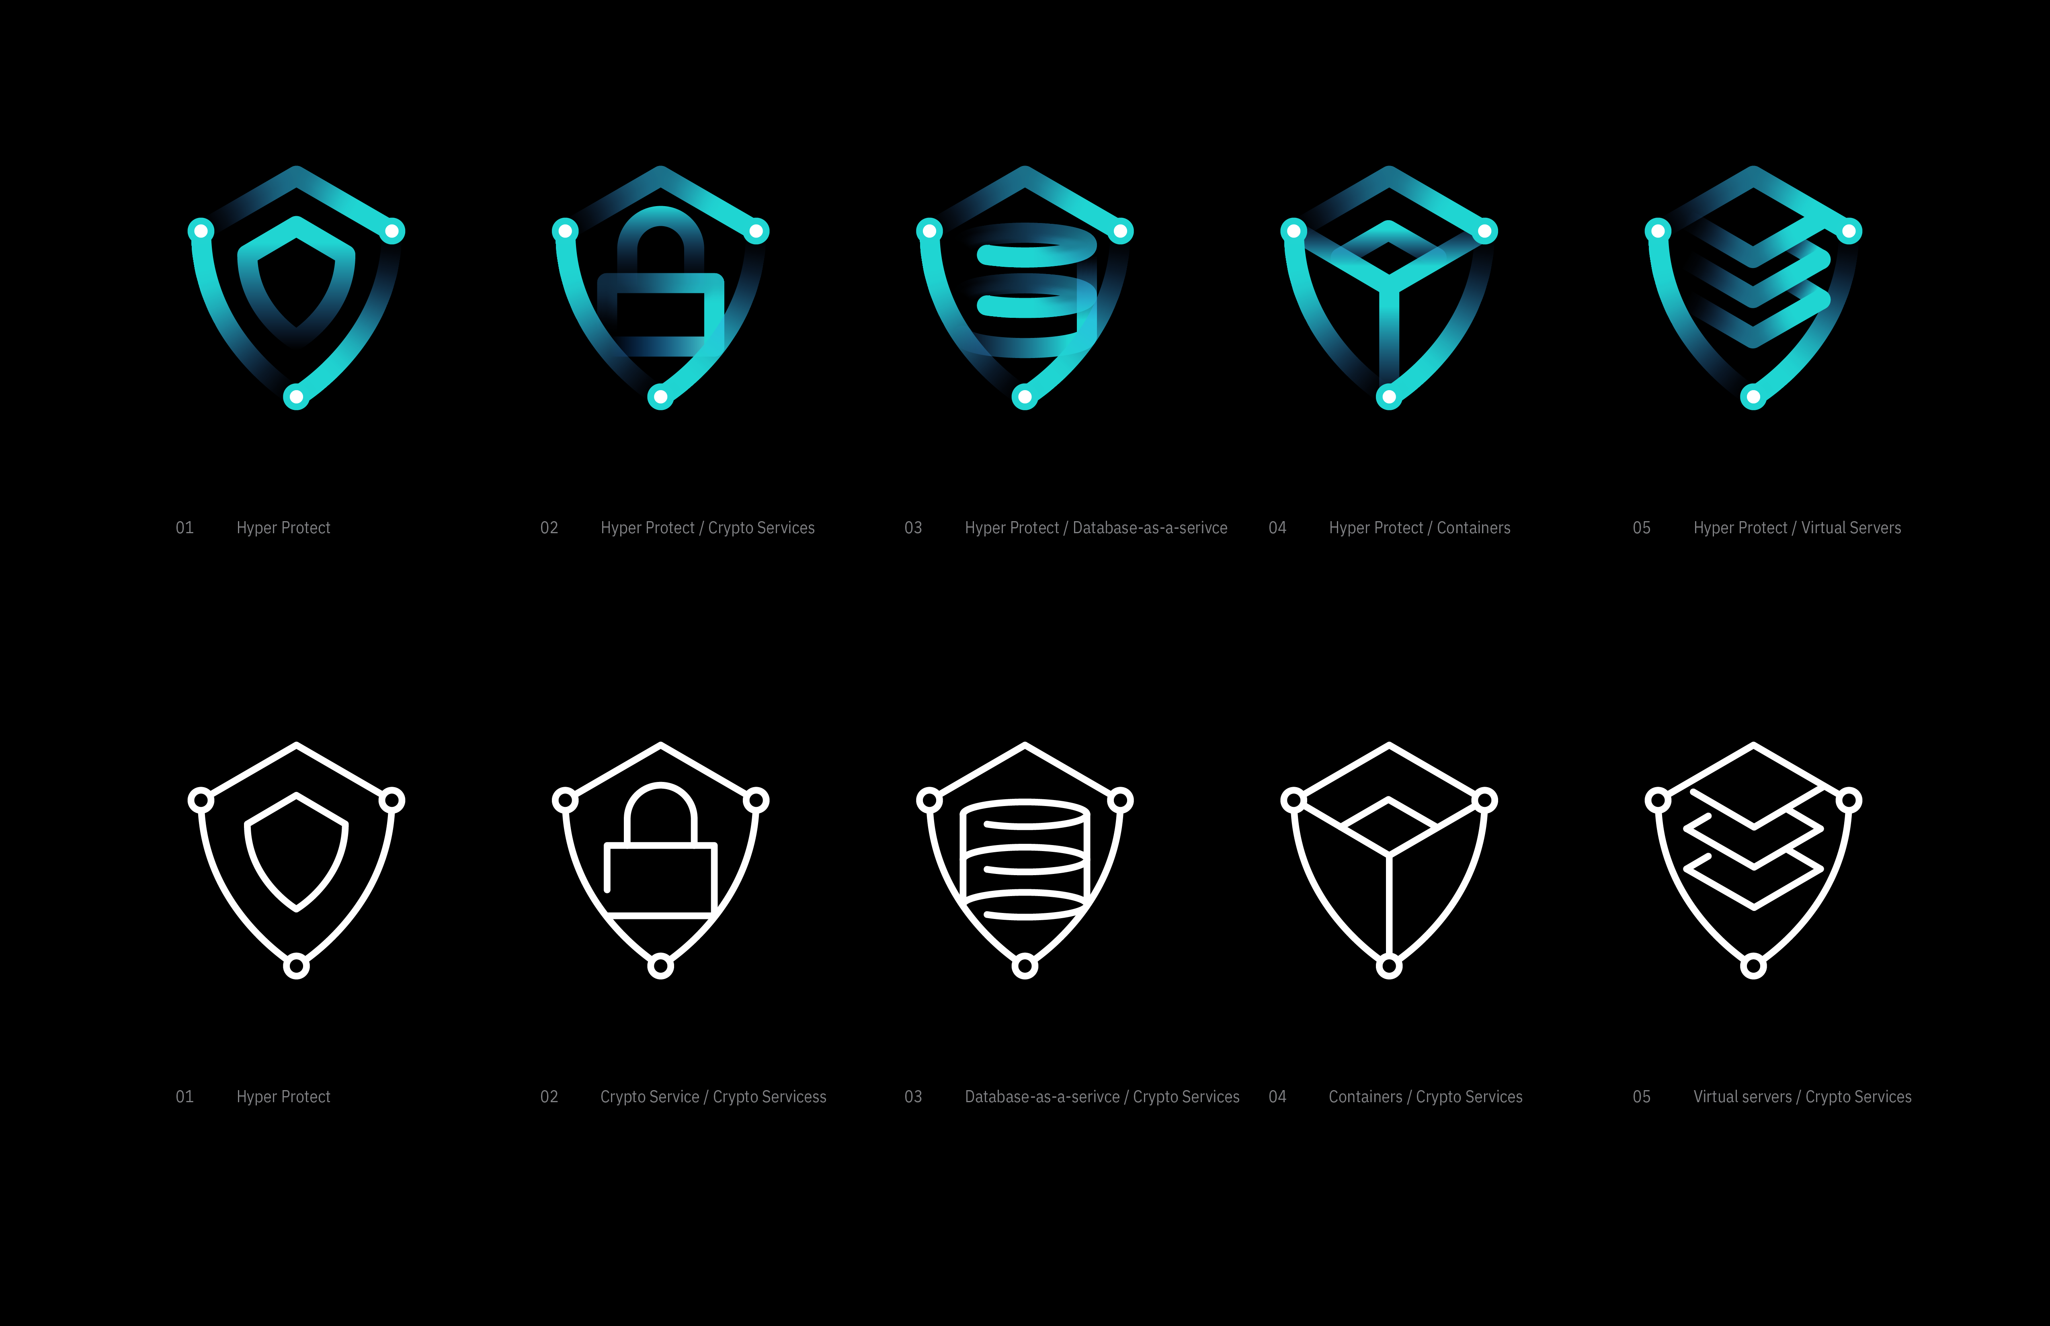



IBM Cloud Hyper Protect Services
Industry-leading security for Cloud data, digital assets and workloads
Hyper Protect
Crypto Services
.
Hyper Protect
DBaaS
Hyper Protect
Virtual Servers
Hyper Protect Containers
GA
GA
GA
2020
Keep your own keys for cloud data encryption protected by a dedicated cloud HSM*
Fully managed cloud HSM as a service – no charge for first 60 days!
Complete data confidentiality for your sensitive data
Complete authority over your LinuxONE Virtual Servers for workloads with sensitive data or business IP
Build and deploy micro services within a hyper secure environment
Get Started with free version on the IBM Cloud PostgreSQL MongoDB EE
* Built on industry’s only
FIPS 140-2 Level 4 certified Cloud HSM
(Ubuntu)
(Kubernetes)
Only you have access to your data, encryption keys and workloads
Even the IBM cloud admin has no access!
Secure Enclaves
Built On
Notes:
https://ibm.seismic.com/Link/Content/DCjzj1AnlSl0mlgEXESAPQqg
Introducing IBM cloud Hyper Protect Services – secure cloud services for migrating and developing cloud enabled workloads with sensitive data. These offerings provide the security and peace of mind that enterprises need to take advantage of the cloud, without taking risks with brand reputation and client data.
Hyper Protect Crypto Services – GA March 2019
Keep your own keys for cloud data encryption in a dedicated cloud HSM. This provides Key Lifecycle Management and support for Keep Your Own Key (KYOK) for cloud data encryption, with keys protected by customer controlled, dedicated cloud HSMs. This offering provides industry's first and only FIPS 140-2 Level 4 certified HSMs in the public cloud market today with industry standards such as PKCS#11. In addition, IBM is the first cloud provider to provide CLI for HSM Key Ceremony, supporting multiple personnel with crypto key responsibilities.
Hyper Protect DBaaS – 2Q 2019
Allows customer to provision and manage highly secure databases (PostgreSQL, MongoDB EE) with complete data confidentiality for sensitive data. Industry-leading data confidentiality through built-in workload isolation, restricted administrator access, tamper protection against internal threats. IBM cloud admins cannot ever access customer data –all the security without sacrificing on high availability or reliability for mission critical workloads. This offering also supports industry compliance and certifications as well as providing standard APIs to provision, manage, maintain and monitor multiple database types.
Hyper Protect Virtual Servers – Beta in 3Q19, GA 4Q19
Protection in the cloud for workloads with sensitive data or business IP through built-in workload isolation, tamper protection against internal threats and privileged user access, and again, no cloud admins access to the workloads. Users are able to create virtual servers with own public SSH key to maintain exclusive access to code and data, without sacrificing on performance and ease of use. This offering integrates with IBM Cloud services for access management, logging and monitoring,
Hyper Protect Containers – Coming soon!
This offering provides the ability to build and deploy micro services within a hyper secure environment.

Slide 24
Section 2.2 – Understand the benefits and options for IBM Kubernetes Service
Components of IKS
IKS Cluster
IKS Registry
IKS Helm Catalog
IKS Benefits
IKS Compute Choices
VSIs
Dedicated
Bare Metal
IKS Availability Zone choices and Benefits
https://cloud.ibm.com/docs/containers?topic=containers-getting-started

Slide 25
Cloud is abstracting away from the infrastructure and enabling applications to ‘just run’

Slide 26
Levels of Abstraction

Slide 27
What are Containers?
A container is a unit of software that contains all the components required to run and application, including all its dependencies, libraries, other binaries and so on

Slide 28
Why Containers?
They achieve much higher densities than virtual machines
We have the tools to manage them
They are portable

Slide 29

OK but what about…..
Docker
Kubernetes / Kubes / K8
Red Hat OpenShift

Slide 30
What’s the difference?
Vs.
Project
Product
Unopinionated
Opinionated
Build your own ‘day 2’
Just go, it’s all there

Slide 31
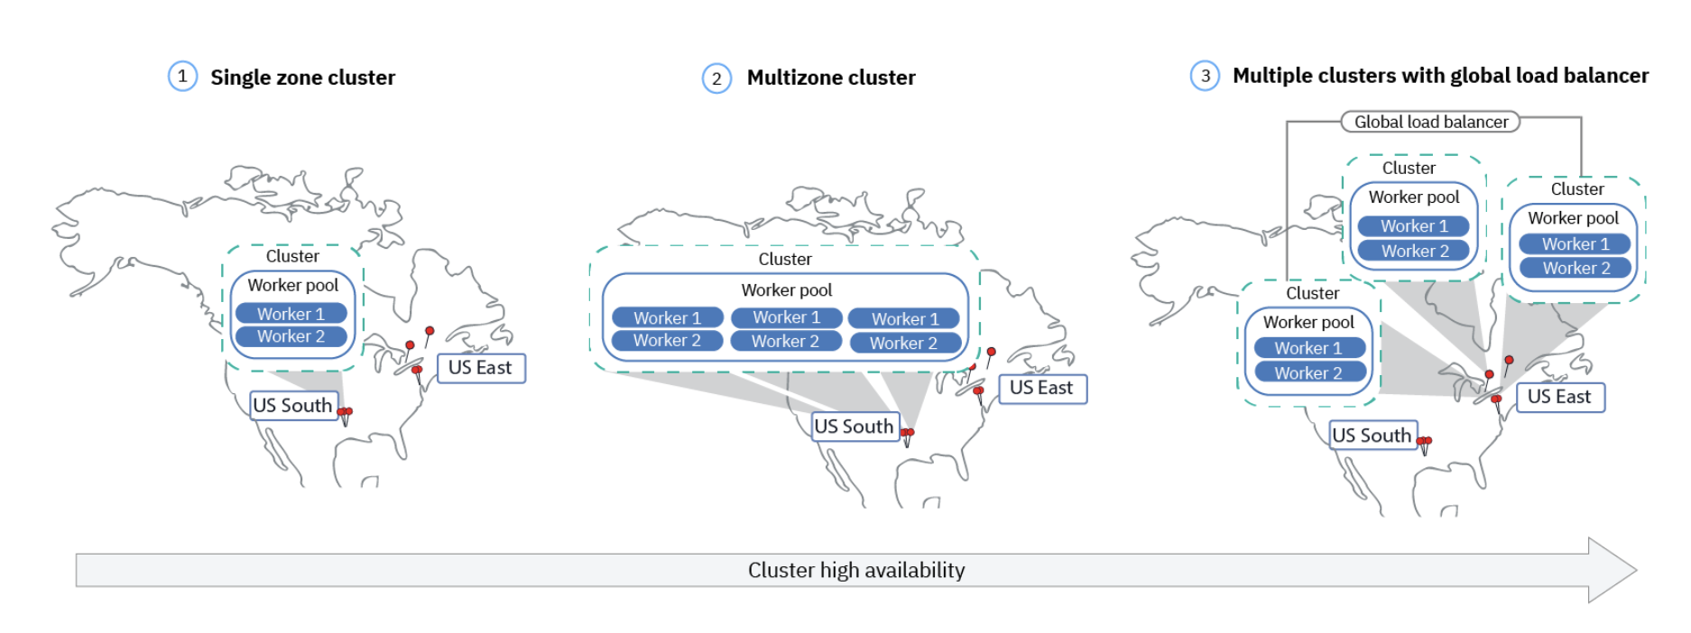
Containerization – built for High Availability
© 2020 IBM Corporation

Slide 32
Container Registry
Provides a Private registry in which to store Docker containers which you want to deploy to your Kubes or OS deployment
Images are checked for security issues
Highly available and managed by IBM
Can create multiple namespaces within your Registry
There is a free storage and pull traffic quota (0.5GB / 5GB)

Slide 33
Helm Catalog
Helm is a type of ‘package manager’ for Kubernetes
Use it to easily deploy complex apps in a repeatable way
IBM Cloud Catalog contains 70 Helm charts for different applications

Slide 34
Kubernetes Demo How to Deploy Container Registry Helm Catalog

Slide 35
Section 2.3 – Understand the benefits and options for IBM Red Hat OpenShift
What is Red Hat OpenShift on IBM Cloud (ROKS)
Red Hat OpenShift on IBM Cloud is a managed offering to create your own OpenShift cluster of compute hosts to deploy and manage containerized apps on IBM Cloud. Red Hat OpenShift on IBM Cloud provides intelligent scheduling, self-healing, horizontal scaling, service discovery and load balancing, automated rollouts and rollbacks, and secret and configuration management for your apps. Combined with an intuitive user experience, built-in security and isolation, and advanced tools to secure, manage, and monitor your cluster workloads, you can rapidly deliver highly available and secure containerized apps in the public cloud.
Benefits of IBM Red Hat OpenShift (ROKS)
Enterprise grade Kubernetes service managed by IBM with MZR support for 99.99% availability SLA
IBM Cloud security hardening and best practices
Red Hat integration, testing, commercializing, and support
Developer friendly features like IAM, Registry, S2I, Templates, CI/CD built-in, administration UI/CLI
ROKS Compute Choices
VSIs
Dedicated
Bare Metal
ROKS Availability Zone choices and Benefits
https://cloud.ibm.com/docs/openshift?topic=openshift-getting-started

Slide 36
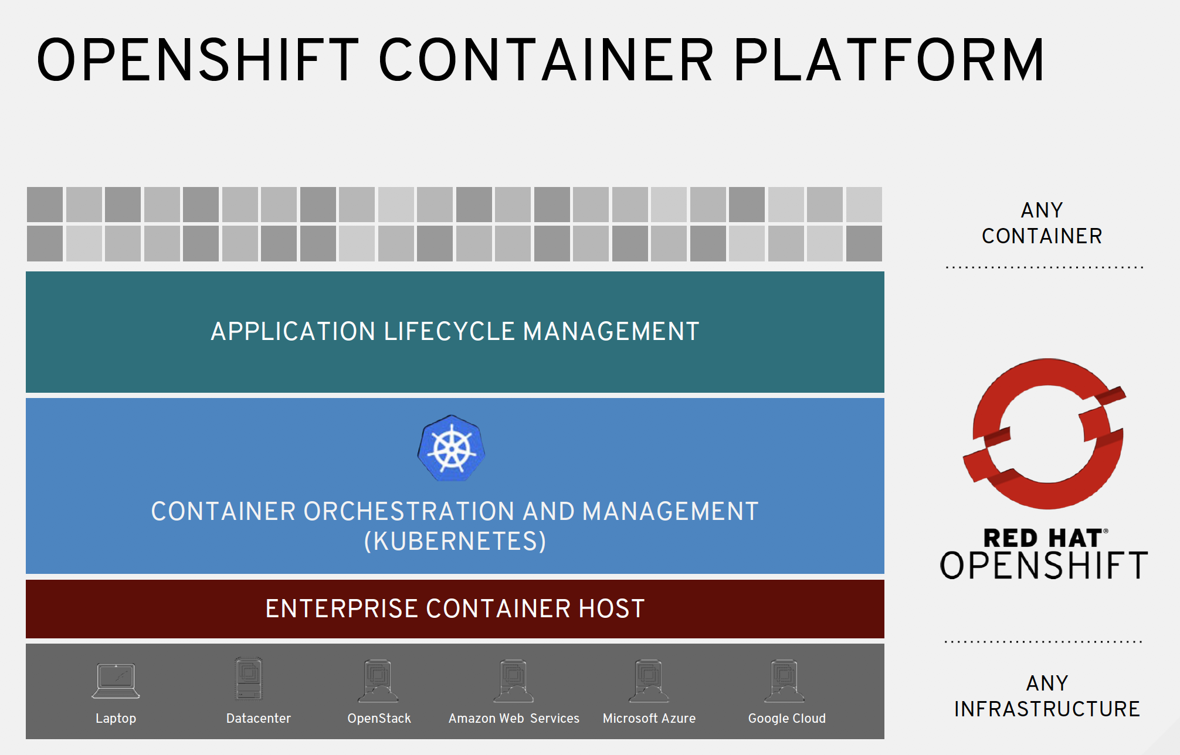
Notes:
innovation is on the left....moving to right is the value of a stand alone, integrated, world-class support enterprise offering

Slide 37
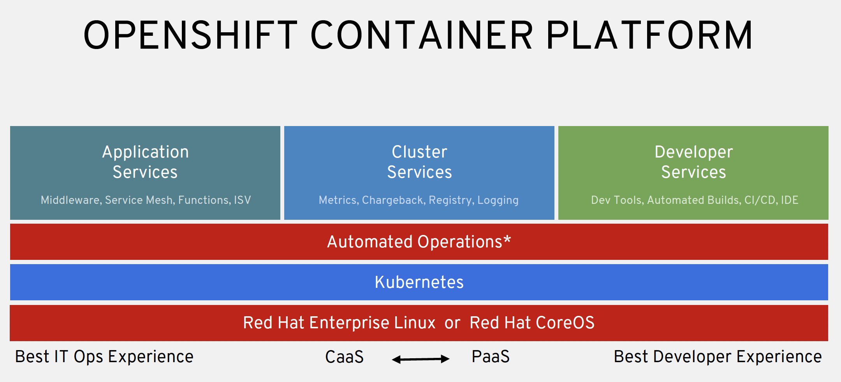
Notes:
innovation is on the left....moving to right is the value of a stand alone, integrated, world-class support enterprise offering

Slide 38
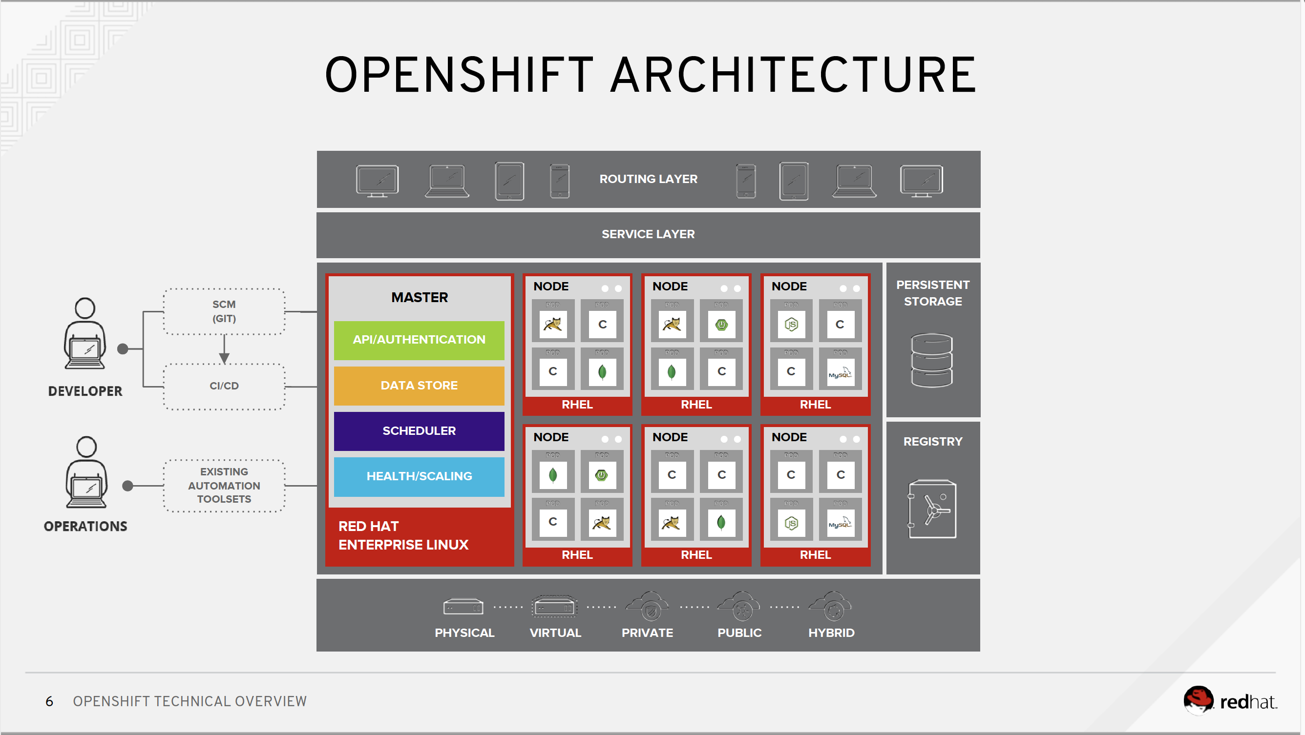
Notes:
innovation is on the left....moving to right is the value of a stand alone, integrated, world-class support enterprise offering

Slide 39
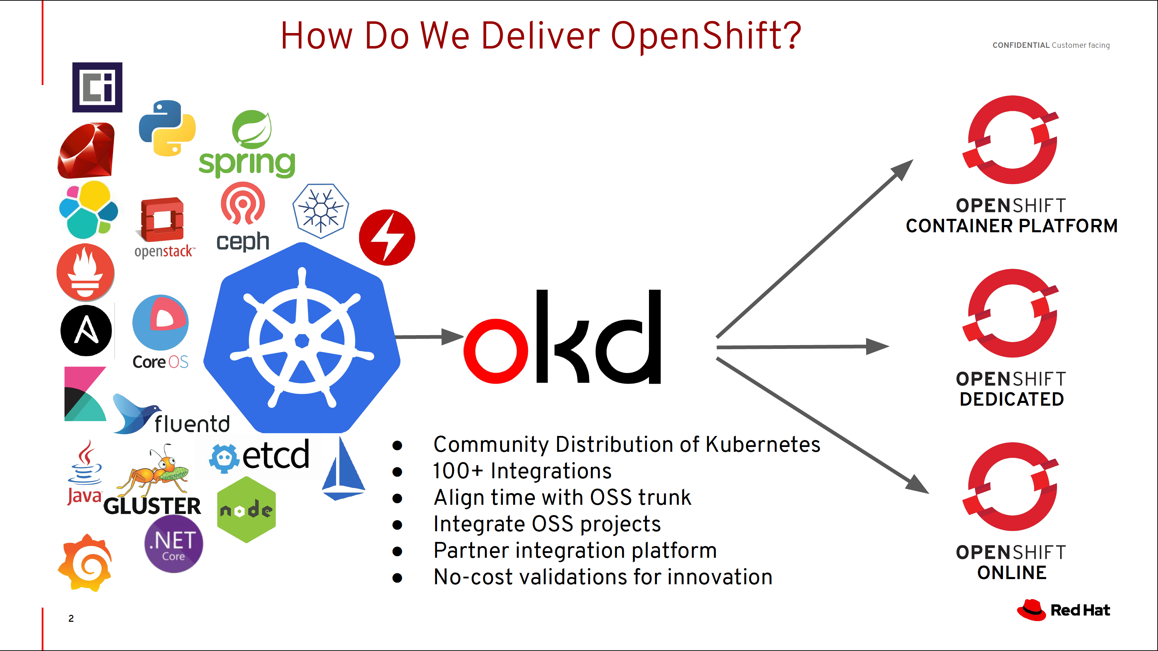


UPDATE?
UPDATE?
Why OpenShift?
Thousands of OSS projects…
…integrated on one, rich platform
UPDATE?
UPDATE?
Notes:
innovation is on the left....moving to right is the value of a stand alone, integrated, world-class support enterprise offering

Slide 40
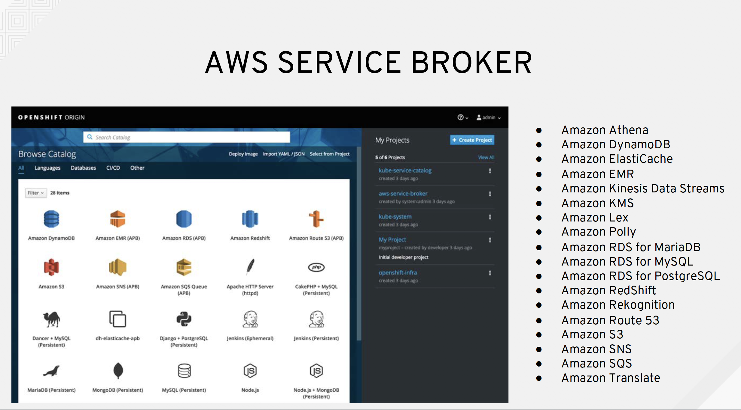
Notes:
innovation is on the left....moving to right is the value of a stand alone, integrated, world-class support enterprise offering

Slide 41
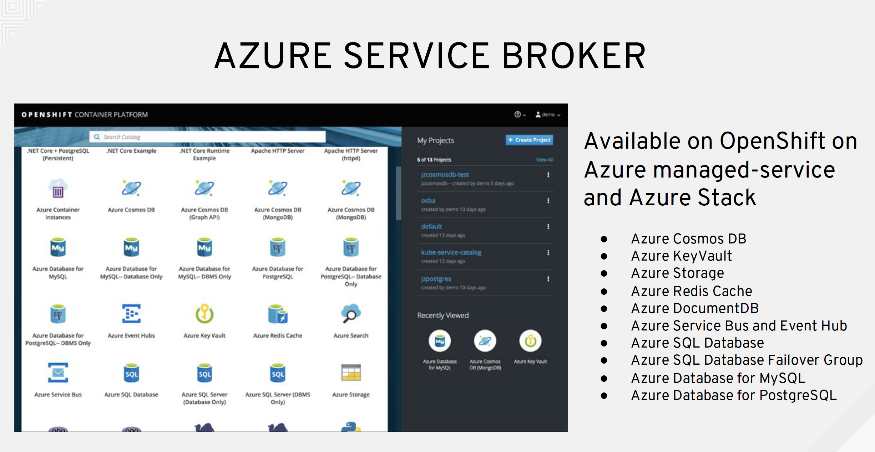
Notes:
innovation is on the left....moving to right is the value of a stand alone, integrated, world-class support enterprise offering

Slide 42
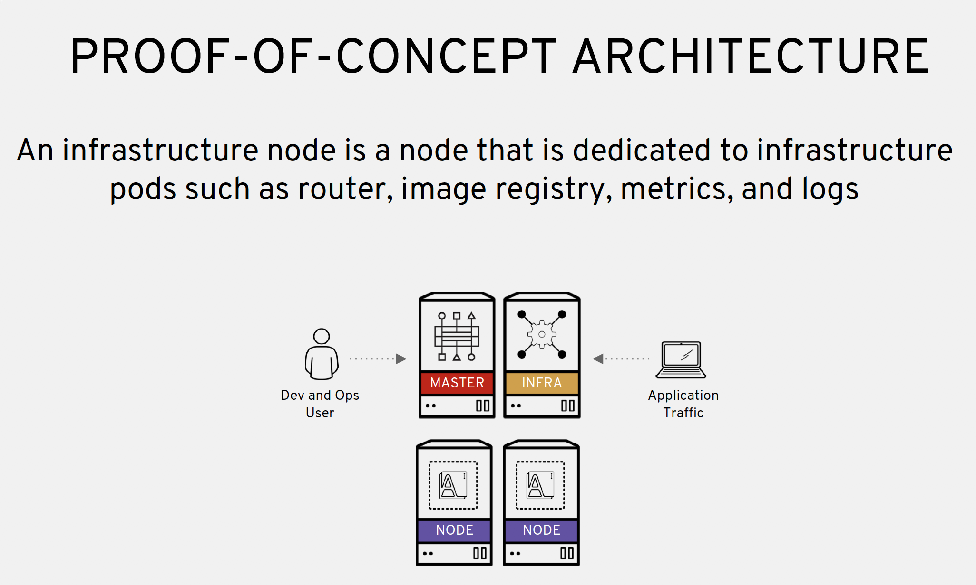
Notes:
innovation is on the left....moving to right is the value of a stand alone, integrated, world-class support enterprise offering

Slide 43
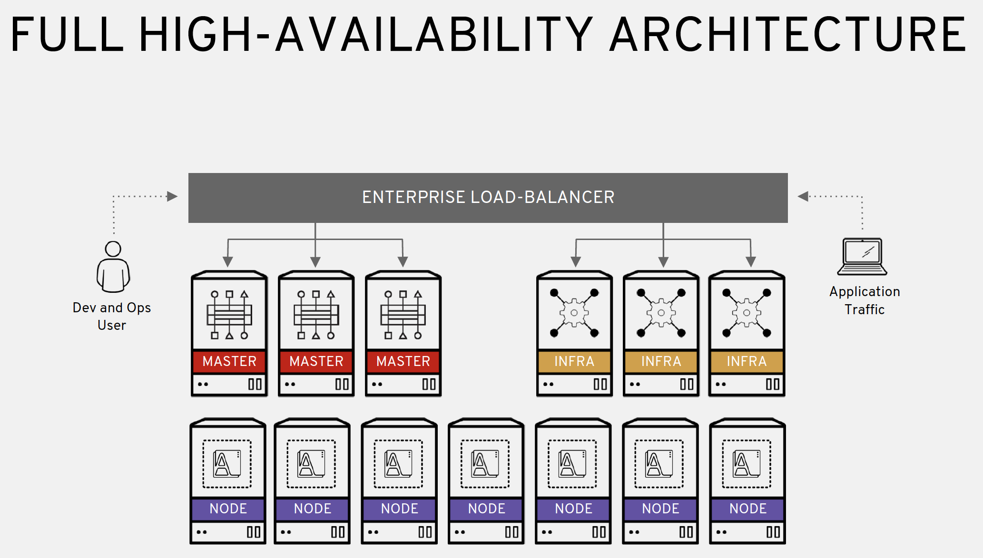
Notes:
innovation is on the left....moving to right is the value of a stand alone, integrated, world-class support enterprise offering

Slide 44
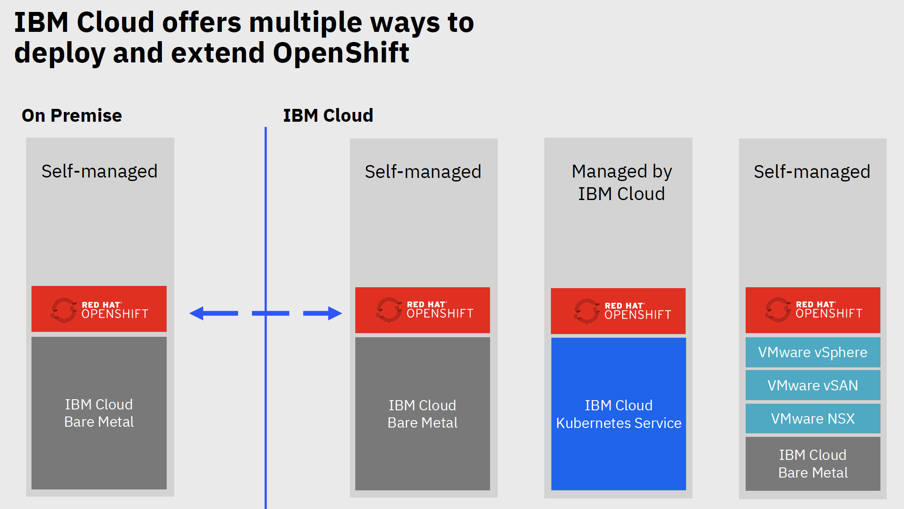
Your Hardware

Slide 45


Red Hat OpenShift on IBM Cloud
A cloud service providing an intuitive user experience with simplified cluster lifecycle management on native OpenShift clusters.
Includes built-in security and isolation to enable rapid delivery of apps, while leveraging 190+ IBM Cloud services.
Available in six IBM regions worldwide, including 35+ datacenters.
As-a-Service Value
Automated provisioning
Installation
Configuration
Upgrades
Patch management
Scaling
Performance tuning
24/7 global SRE support
Engage with experts via Slack
Resilient and Secure
MZR HA with automatic failure recovery
MZR HA master nodes
Auto-scaling
Security hardening
Compliance (GDPR, HIPAA, PCI, SOC1/2)
Compute choice of VSIs, bare metal
99.99% SLA
Complete Platform
Built-in monitoring
Built-in logging
BYOK key protection
KYOK key protection
IAM
Activity Tracker
Storage options (File, Block, Object)
Security Advisor
Service Catalog
Container Registry
Vulnerability Advisor
Full admin rights
Differentiated
Red Hat OpenShift on IBM Cloud | ©2020 IBM Corporation
Learn more: ibm.biz/sellOpenShift

Slide 46
https://cloud.ibm.com/docs/containers?topic=containers-ha_clusters#ha_clusters

Slide 47
What does IBM manage for you?
Automated provisioning and configuration of Infrastructure (compute, network and storage)
Automated installation and configuration of OpenShift, including HA cross zone configuration
Automatic upgrades of all components (operating system, OpenShift components, and in cluster services)
Security patch management for OS and OpenShift
Automatic failure recovery for OpenShift components and worker nodes
Automatic scaling of OpenShift configuration
Automatic backups of core OpenShift ETCD data
Built in integration with cloud platform - monitoring, logging, KeyProtect, IAM, ActivityTracker, Storage, COS, Security Advisor, Service Catalog, Container Registry and Vulnerability Advisor
Built in Load Balancer, VPN, Proxy, Network edge nodes, Private Clusters and VPC capabilities
Built-in Security including image signing, image deployment enforcement, and hardware trust
24/7 global SRE team to maintain the health of the environment and help with OpenShift
Global SRE has deep experience and skill in IBM Cloud Infrastructure, Kubernetes and OpenShift, resulting in much faster problem resolution
Automatic compliance for your OpenShift environment (HIPAA, PCI, SOC2, ISO)
Capacity expansion through a single click
Automatic multi-zone deployment in MZRs, including integration with CIS to do cross zone traffic routing
Automatic Operating System performance tuning and security hardening

Slide 48
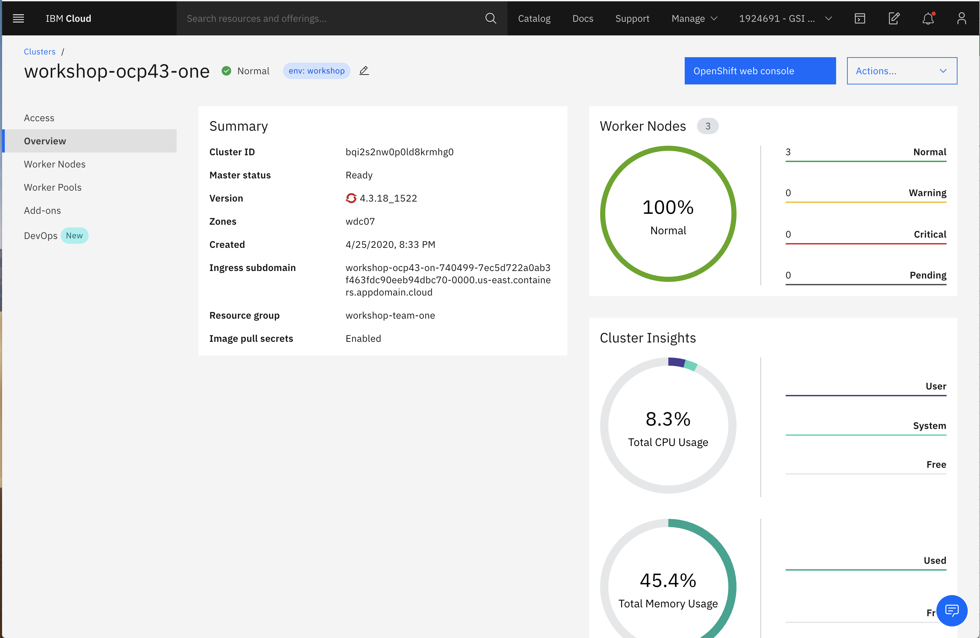
Section 2.3 – ROKS Demo
https://docs.openshift.com/container-platform/3.11/getting_started/developers_console.html

Slide 49
Section 2.4 – Understand the benefits and options for IBM Virtual Private Cloud
What is a Virtual Private Cloud (VPC)
IBM Cloud™ Virtual Private Cloud (VPC) allows you to create your own space in the IBM Cloud, to run an isolated environment within the public cloud. VPC gives you the security of a private cloud, with the agility and ease of a public cloud.
VPC is a logical “software defined network”.
VPCs are isolated from other VPCs.
IBM Virtual Private Cloud (VPC) Benefits
Bring your own IP (BYOIP)
Logical Isolation
Simplifies network setup
IBM Virtual Private Cloud (VPC) Components - https://cloud.ibm.com/docs/vpc?topic=vpc-about-networking-for-vpc
Region, VPC, Zone, Subnet, Floating IP Address, Implicit Router, Security Group, Public Gateway, Access Control Lists, VPN, Load Balancers, Block Storage Volumes
https://www.ibm.com/cloud/learn/vpc

Slide 50




IBM Cloud VPC Networking Model
Network isolation takes place at:
Hypervisor - A VSI can not reach other VSIs hosted by the same hypervisor if they are not in the same VPC.
Network - Virtual network identifiers are added to all data packets:
entering from the hypervisor, when sent by a VSI.
when sent by the implicit routing function.
Router: The implicit router isolates each VPC by using a virtual routing function (VRF) and a VPN with MPLS (multi-protocol label switching) in the cloud backbone:
VRF allows each VPC to have access to its own copy of the IP address space.
MPLS VPN allows for federating the edges of the cloud: Classic Infrastructure, Direct Link, and VPC.
VPN Gateway - Secure connection via an encrypted tunnel between customer and VPC. Adheres to common protocol and encryption standards
Public Gateway (PGW) - Connects subnets and their attached VSIs to the Internet.
Floating IP (FIP) - Internet accessible IP address from pool of available addresses. Associated with an instance in a VPC for inbound connectivity.
IBM Cloud
Region A
VPC 1
Zone 1 10.10.0.0/16
Zone 2 10.20.0.0/16
USER
PUBLIC LOAD
BALANCER
Public Subnet 10.10.10.0/24
Public Subnet 10.20.30.0/24
ACL
ACL
PUBLIC
GATEWAY
INTERNET
Security Group 1
FLOATING IP
VSI
VSI
VPN
CONNECTION
VPN
GATEWAY
Private Subnet 10.10.20.0/24
PRIVATE LOAD
BALANCER
Private Subnet 10.20.40.0/24
ACL
ACL
Security Group 2
VSI
VSI
Virtual Server Instances (VSI) - Fast provisioning, multi-homed, multiple vNICs. Hourly pricing and suspend billing.
Block Storage - Available as VSI Boot Disk and as secondary storage. Mount and go, no OS configs needed
https://cloud.ibm.com/docs/vpc-on-classic-network?topic=vpc-on-classic-network-working-with-ip-address-ranges-address-prefixes-regions-and-subnets

Slide 51





IBM Cloud VPC Networking Model
Access Control List (ACL) - Stateless ACLs enable subnet level firewall for ingress and egress traffic.
Security Groups (SG) - Security rules for controlling traffic flows to/from virtual server instances.
Load Balancer - Layer 4-7 load balancing. Round Robin, weighted RR and least connections algorithms.
Direct Link - Private network connectivity between on-premises workloads and IBM Cloud. Support for BYOIP. Secure method with dedicated high bandwidth options.
Terraform supported to easily define VPC-enabled solutions and manage the lifecycle of those cloud resources in an automated fashion,
Developer friendly API that easily integrates to existing tooling.
VPC users and permissions are fully integrated into IAM and the IBM Cloud platform.
Import Custom Images from IBM COS.
IBM Cloud
ENTERPRISE
Region A
Classic Infrastructure
VPC 1
ENTERPRISE USER
Zone 1 10.10.0.0/16
Zone 2 10.20.0.0/16
BARE METAL
SERVERS
Private Subnet 10.10.20.0/24
LOAD
BALANCER
Private Subnet 10.20.40.0/24
ACL
ACL
DIRECT
LINK
ENTERPRISE APPLICATION
VSI
Security Group 1
VSI
IMPLICIT ROUTER
ENTERPRISE DATA
Create a single or multiple transit gateways to connect VPCs together and link to an IBM Cloud classic infrastructure.
Any new network connected to a transit gateway is then automatically made available to every other network connected to it:
Connect VPCs in the same region (local routing).
Connect VPCs in different regions (global routing).
Connect VPCs to your IBM Cloud classic infrastructure.

Slide 52
VPC Features
Regions, Availability Zones, Subnets
Multi Zone Regions (MZR)
An IBM Cloud region with three availability zones that are logically and physically independent from one another but networked together
Classic Infrastructure:
Data Centers
PODS
Availability Zones (AZ)
Independent fault domains that do not share physical infrastructure
An abstracted service end-point for fault tolerance
Have latency requirement of <500 usec intra-zone & <2 ms inter-zone
Available
VPC
5 per region
VPCs w/ Classic Access
1 per region, per account
Subnet
15 per VPC
MZRs
us-south (DAL)
jp-tok (TOK)
eu-gb (LON)
au-syd (SYD)
eu-de (FRA)
Subnet
Isolated networks, typically with open communication within the subnet, but controlled access to networks outside of the subnet, including the internet.
Allows private address spaces with RFC1918
Allows BYO Subnet range in addition to default range provided
Gen 1
MZRs
Gen 2
us-south (DAL)
eu-gb (LON)
us-east (WDC)
For up-to-date quotas always refer to the Cloud Docs page

Slide 53
VPC Features
Network Security
Classic Infrastructure:
Vyatta
Fortigate
Security Groups
Access Control List (ACL)
Enables customers to allow/deny ingress traffic to subnet and egress traffic from subnet
ACL is stateless
ACL consists of rules and each rule has source IP, source port, destination IP, destination port and protocol
Available
ACLs
30 per region
20 ingress rules per ACL
20 egress rules per ACL
SGs
500 per account
5 per network interface
50 rules per Security Group
5 remote rules per security group
100 NICS per SG
Gen 2
Gen 1
ACLs
25 per VPC
25 ingress rules per ACL
25 egress rules per ACL
SGs
25 per VPC
25 rules per Security Group
5 remote rules per security group
Security Groups for VPC
A virtual firewall that controls the traffic for one or more VSIs within a VPC
A collection of rules that allow traffic to or from its associated VSI
Allows for modification of those rules
Gen 1
Gen 2
For up-to-date quotas always refer to the Cloud Docs page

Slide 54

VPC Features
Compute
Virtual Server Instances
Multi- homed
Multiple vNIC
Profiles of pre-defined vcpu/RAM configurations
Balanced (1 vCPU: 4 GB RAM)
Compute (1:2)
Memory (1:8)
POWER Processor based VSI Profiles:
Balanced (1 vCPU:4 GB RAM)
Compute (1:2)
Memory (1:8)
GPU - 2 or 4 Tesla v100 GPUs
Includes new larger sizes up to
62x248 48x192
Basic Platform Integration: IAM, Resource Groups, Usage Dashboard
Basic monitoring and logging
Stock OS options – x86:
CentOS 7.x
Ubuntu 16.04, 18.04
Debian 8.x , 9.x
Windows 2016, 2012 R2, 2012
RHEL 7.x
Stock OS options – POWER:
CentOS 7.x
Ubuntu 18.04
Debian 9.x
Custom image import
SSH only authentication for Linux images
Gen 1
Classic Infrastructure:
VSIs
Available
Gen 1
Gen 2
VSIs
100 VSIs per account
5 vNICs per VSI
1 Floating IP Address per VSI
100 SSH keys per account
Up to 16Gbps
Provision in minutes
VSIs
200 vCPUs per region
800GB RAM per region
5 vNICs per VSI
1000 SSH keys per account
Up to 80 Gbps
Provision in seconds
Gen 1
Gen 2
All VSIs will require a 100 GB primary volume
Primary volume is Block Storage with General Purpose Tier (3 IOPs per GB)
Users will be billed for storage
For up-to-date quotas always refer to the Cloud Docs page

Slide 55

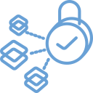

VPC Features
Hybrid Connectivity
VPN-as-a-Service
Secure connection via an encrypted tunnel between customer and VPC or VPC to VPC
Adheres to common protocol and encryption standards
Classic Infrastructure:
IPSec VPN
Direct Link
Direct Link via Classic Access
Private connectivity for maximum speed, security and resiliency
Variety of connectivity options and port speeds from 50Mbps to 10Gbps in one of IBM Cloud's global data centers
Over 30 partners to choose from worldwide
Available
VPN
20 gateways per account
3 gateways per zone
10 VPN connections per gateway
Direct Link
Requires VPC w/ Classic Access
Transit Gateway
10 free connections per account
50 connections per gateway
In MZRs only
Transit Gateway
VPC to Classic | VPC to VPC
Point-to-point connectivity | Point-to-point connectivity
VPC hub to Classic as a spoke | Hub-to-spoke connectivity
Up to five interconnected VPCs per region and one Classic domain | Up to five interconnected VPCs per region Inter-region VPC connectivity with no complications from Classic IP networks
For up-to-date quotas always refer to the Cloud Docs page

Slide 56
Positioning Classic Infrastructure and VPC Infrastructure
Classic
VPC
Existing IaaS Platform
Ideal for "Lift & Shift” workloads
Bare Metal
Market leading service
VMware & SAP
Flexible deployment options
Network Appliances
Multiple vendors to choose from
Enterprise Storage Protocols
iSCSI and NFS-based offerings
All-new IaaS Platform
Ideal for Cloud Native + Cloud Enabled
Unified Experience
Fully integrated into IBM Cloud Platform
Developer Friendly API
New REST-based API aligned to industry
Faster, More Scalable Provisioning
Provision more resources, faster
Virtual Networking
Manage network topology via API, network performance up to 80Gbps
Strong Connectivity
fast, simple to use together
Databases, SAP, VMware, GPU-based Workloads
Web-facing applications, batch workloads, simulations, event streaming

Slide 57
Positioning Classic Infrastructure and VPC Infrastructure
Classic
POWER9
w / Linux - GPUs
VPC
Existing IaaS Platform
Ideal for "Lift & Shift” workloads
Bare Metal
Market leading service
VMware & SAP
Flexible deployment options
Network Appliances
Multiple vendors to choose from
Enterprise Storage Protocols
iSCSI and NFS-based offerings
All-new IaaS Platform
Ideal for Cloud Native + Cloud Enabled
Unified Experience
Fully integrated into IBM Cloud Platform
Developer Friendly API
New REST-based API aligned to industry
Faster, More Scalable Provisioning
Provision more resources, faster
Virtual Networking
Manage network topology via API, network performance up to 100Gbps
GPU-based workloads
Acceleration for AI and ML/DL workloads with 2 or 4 Tesla V100 GPUs
Strong Connectivity
fast, simple to use together
SkyTap and Power Systems Virtual Servers on IBM Cloud
Databases, SAP, VMware, GPU-based Workloads
Web-facing applications, batch workloads, simulations, event streaming

Slide 58


IBM Cloud VPC Key Advantages
Hyperscale provisioning, 1000 VM’s in less than 4 mins consistently
Best in class networking performance between VPC servers – up to 80 Gbps for general purpose Virtual Server profiles and 100 Gbps for POWER profiles
Accelerated GPU profiles based on Power Systems offer up to 3X faster AI model training vs. x86
New developer friendly, REST-based API aligned to industry norms and easily integrating to existing tooling
Security – Support for KYOK with highest level of FIPS certification, 140-2 Level 4

Slide 59
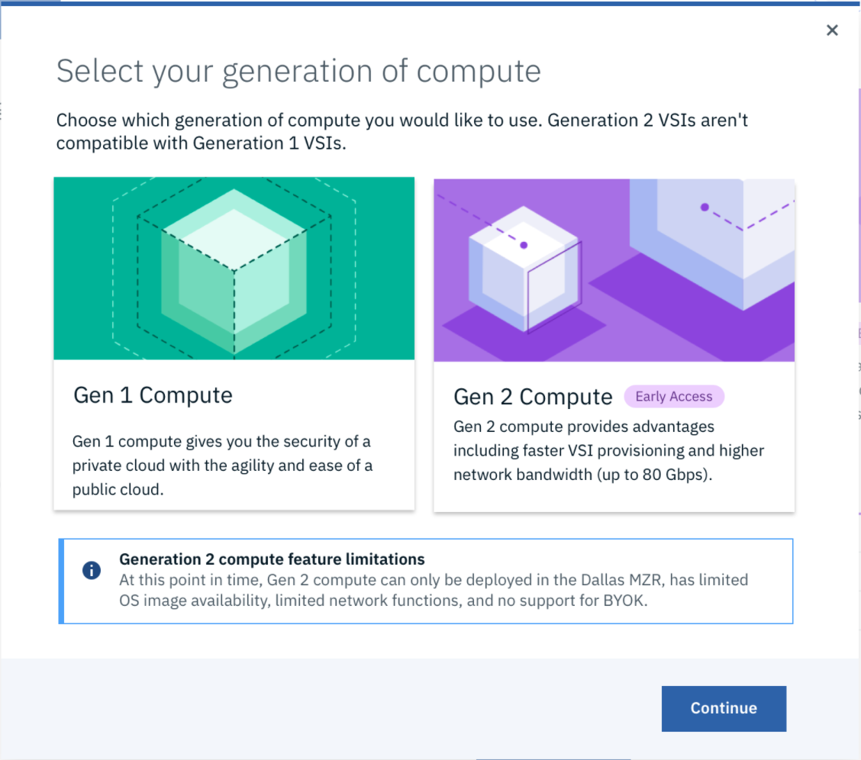


Gen 2 Virtual Servers for VPC
One VPC Infrastructure
Two generations of compute
Gen 2 Virtual Servers for VPC introduces the latest set of functionality and performance, while maintaining the same API conventions and surrounding services first introduced with Gen 1 Virtual Servers.
Simulations
In-Memory Cache
Event Streaming
Best in Class Up to 100 Gbps Networking Performance for General Purpose Instances
Competitive Provisioning Speeds, At Scale
https://cloud.ibm.com/docs/overview?topic=overview-compare-vpc-vpcoc

Slide 60
IBM Offering Highest Network Performance on General Purpose Profiles of any vendor
 | Gen 2 Profile on VPC Instance |  |  | AWS Instances |  |  | Azure Instances |  |  | Google Machine Types
 | bx2-2x8 | 4 Gbps |  | m5.large | up to 10 Gbps |  | D2 v3 | 1 Gbps |  | n2-standard-2 | 4 Gbps
 | bx2-4x16 | 8 Gbps |  | m5.xlarge | up to 10 Gbps |  | D4 v3 | 2 Gbps |  | n2-standard-4 | 8 Gbps
 | bx2-8x32 | 16 Gbps |  | m5.2xlarge | up to 10 Gbps |  | D8 v3 | 4 Gbps |  | n2-standard-8 | 16 Gbps
 | bx2-16x64 | 32 Gbps |  | m5.4xlarge | up to 10 Gbps |  | D16 v3 | 8 Gbps |  | n2-standard-16 | 16 Gbps
 | bx2-32x128 | 64 Gbps |  | m5.8xlarge | 10 Gbps |  | D32 v3 | 16 Gbps |  | n2-standard-32 | 16 Gbps
 | bx2-48x192 | 80 Gbps |  | m5.12xlarge | 10 Gbps |  | D48 v3 | 24 Gbps |  | n2-standard-48 | 16 Gbps
 | cx2-2x4 | 4 Gbps |  | c5.large | up to 10 Gbps |  | F2s v2 | 875 Mbps |  | Custom | 4 Gbps
 | cx2-4x8 | 8 Gbps |  | c5.xlarge | up to 10 Gbps |  | F4s v2 | 1.75 Gbps |  | Custom | 8 Gbps
 | cx2-8x16 | 16 Gbps |  | c5.2xlarge | up to 10 Gbps |  | F8s v2 | 3.5 Gbps |  | Custom | 16 Gbps
 | cx2-16x32 | 32 Gbps |  | c5.4xlarge | up to 10 Gbps |  | F16s v2 | 7 Gbps |  | Custom | 16 Gbps
 | cx2-32x64 | 64 Gbps |  | c4.8xlarge | 10 Gbps |  | F32s v2 | 14 Gbps |  | Custom | 16 Gbps
 | mx2-2x16 | 4 Gbps |  | r5.large | 10 Gbps |  | E2 v3 | 1 Gbps |  | n2-highmem-2 | 4 Gbps
 | mx2-4x32 | 8 Gbps |  | r5.xlarge | 10 Gbps |  | E4 v3 | 2 Gbps |  | n2-highmem-4 | 8 Gbps
 | mx2-8x64 | 16 Gbps |  | r5.2xlarge | 10 Gbps |  | E8 v3 | 4 Gbps |  | n2-highmem-8 | 16 Gbps
 | mx2-16x128 | 32 Gbps |  | r5.4xlarge | 10 Gbps |  | E16 v3 | 8 Gbps |  | n2-highmem-16 | 16 Gbps
 | mx2-32x256 | 64 Gbps |  | r5.8xlarge | 10 Gbps |  | E32 v3 | 16 Gbps |  | n2-highmem-32 | 16 Gbps
In order to get equivalent network performance, if available, you must upgrade to more expensive instances on other clouds
Notes:
Google offers 32Gbps on Skylake instances
Azure 100 Gbps on HPC
AWS 100 Gbps on i3en, c5n, etc

Slide 61

POWER GPU Accelerated VSI Profiles
POWER GPU Profiles
(Tesla V100 GPUs with 32 GB memory)
POWER in VPC Gen 2 Profiles include up to 100 Gbps in Networking Performance
Up to 3 Gbps per vCPU, with a cap at 100 Gbps
This is shared across all network interfaces of a virtual server, and each network interface can generally handle ~24 Gbps
Name | Compute | Memory | Network I/O | PAYGO Price
gp2-16x128x2 | 16 vCPU | 128 GB | 48 Gbps | $5.890 / hr
gp2-24x224x2 | 24 vCPU | 224 GB | 72 Gbps | $6.502 / hr
gp2-32x256x4 | 32 vCPU | 256 GB | 96 Gbps | $11.781 / hr
gp2-56x448x4 | 56 vCPU | 448 GB | 100 Gbps | $13.116 / hr
gp2-56x896x4 | 56 vCPU | 896 GB | 100 Gbps | $15.446 / hr
Available on Ubuntu Linux 18.04
VSI prices lower than comparable x86 offerings!
Notes:
Ingress + egress?
Storage included?
With up to 100 Gbps of network bandwidth, your simulations, in-memory caches, data lakes, and other communication-intensive applications will run better than ever.

Slide 62
Section 2.4 – VPC Demo
https://github.com/billgriffith/ibm-vpc-tutorial

Slide 63
Section 2.5 – Understand the benefits and options for IBM VMWare Solutions
VMWare solution options
VMWare vSphere - dedicated
VMWare vCenter - dedicated
VMWare vCloud Director –shared
VMWare Networking
NSX-T
HCX
VMWare Optional Components
Caveonix RiskForesight
FortiGate Security Appliance
F5 Big IP
HCX
HyTrust
Juniper vSRX
Veeam
Zerto
https://cloud.ibm.com/docs/services/vmwaresolutions?topic=vmware-solutions-getting-started

Slide 64
VMware on IBM Cloud Overview

Slide 65
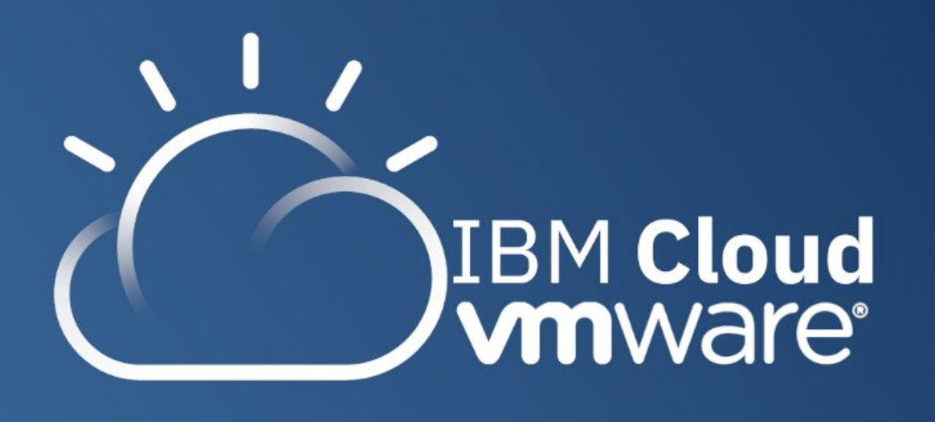
What is VMware on IBM Cloud?
First announced in early 2016
First services available later that year
Provides a means for running VMware workloads in the cloud
IBM Cloud / VMware April 2020 / © 2020 IBM Corporation

Slide 66
Why use VMware on IBM Cloud?
Bring cloud economies to VMware workloads
Scalability / elasticity
High availability
Bursting
Reuse
IBM Cloud / VMware April 2020 / © 2020 IBM Corporation

Slide 67
What VMware Services are Available?
ESXi on a bare metal server
VMware Solutions Dedicated
vCentre Server
VMware vSphere
VMware Solutions Shared
VMware HSX
IBM Cloud / VMware April 2020 / © 2020 IBM Corporation

Slide 68



Other related services
Veeam
Zerto
Caveonix RiskForesight
IBM Cloud / VMware April 2020 / © 2020 IBM Corporation

Slide 69
VMware Solutions Dedicated

Slide 70
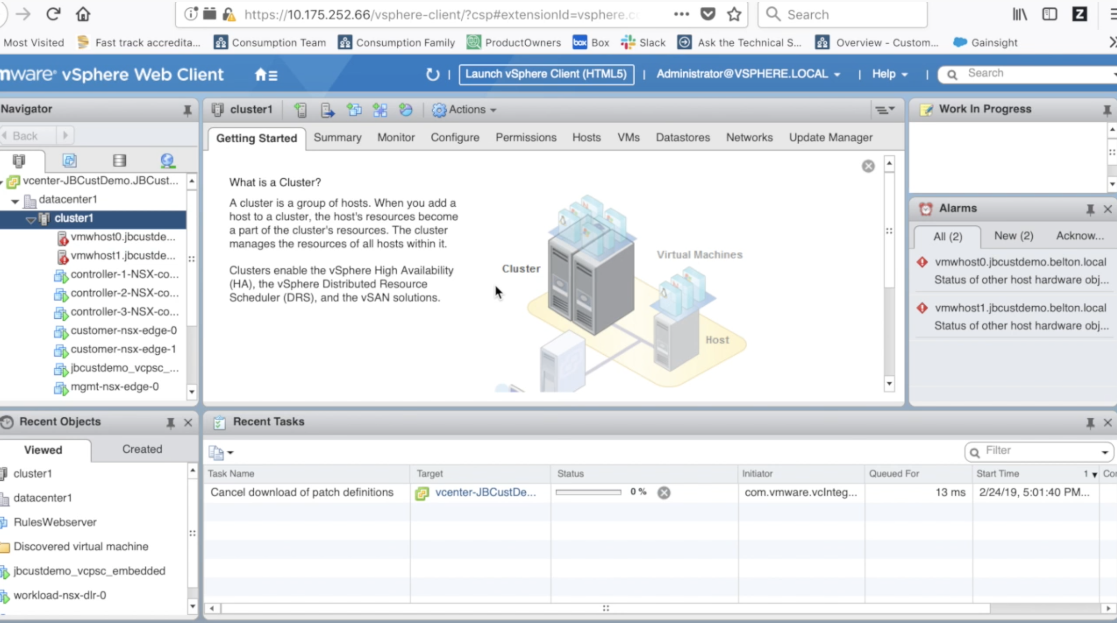
Option video – Getting Started With vCenter
https://youtu.be/BbtQ1UWhxT4
IBM Cloud / VMware April 2020 / © 2020 IBM Corporation

Slide 71
What is VMware Solutions Dedicated?
VMware Solutions Dedicated provides a single-tenant, client-managed VMware Software Defined Data Center (SDDC) solution that is designed to deliver extreme flexibility for customers with root access down to the hypervisor level.
IBM Cloud / VMware April 2020 / © 2020 IBM Corporation

Slide 72
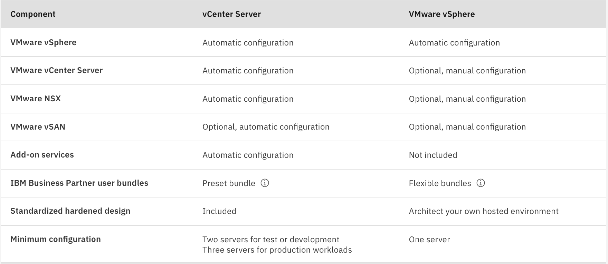
vCentre or vSphere?
IBM Cloud / VMware April 2020 / © 2020 IBM Corporation

Slide 73
Quick Summary
VMWare Solutions Dedicated provides a single-tenant, dedicated Vmware Software Defined DC in IBM Cloud
Choose from vCenter Server or vSphere
vCentre Server is a fully fledged, automated standard VMware stack, whereas vSphere lets you customize the environment
vCenter provides a single zone or a multi-zone stretched cluster
Both allow you to either bring your own licensing or use licenses provide by IBM Cloud
You need either a PAYGO or subscription account to use VMware services
IBM Cloud / VMware April 2020 / © 2020 IBM Corporation

Slide 74
VMware Solutions Shared

Slide 75
What is VMware Solutions Shared?
Standardized and customizable deployment of a Vmware Virtual Data Centre environment
Self-service, on-demand platform, with VMware vCloud Director running on IBM Cloud
Uses public virtual compute (vCPU, RAM, storage, networking and IP.
IBM Cloud / VMware April 2020 / © 2020 IBM Corporation

Slide 76
Why use this?
Cost effective scalability
Great for temporary migration and burst
Disaster recovery
IBM Cloud / VMware April 2020 / © 2020 IBM Corporation

Slide 77
Quick Summary
VMWare Solutions Shared provides a VMware virtual data center in IBM Cloud
It’s based on VMware vCloud Director
It’s provisioned on virtual infrastructure, which can be either ‘on-demand’ or reserved
The deployment is managed through the VMware console and it includes software images for Windows and Linux virtual machines
The deployment includes 5 public IP addresses
IBM Cloud / VMware April 2020 / © 2020 IBM Corporation

Slide 78
VMWare Components on IBM Cloud
Included
Optional
Self Install
VMWare Horizon (VDI)
4
Roll Your Own
IC4V’s automation
1
2
3
Self-managed Dedicated VMware (VSS)
Self-managed Dedicated VMware (VCS)
IBM Cloud-managed Shared VMware (VCD)
vRealize
vCloud Director
HCX
vRealize (for IBM Ops only)
vRealize
vSAN (Adv. or Ent.)
vSAN (2020)
vSAN
NSX-V or NSX-T
(Base, Adv. or Ent.)
NSX-V
NSX-V
vCenter Server
vCenter Server
vCenter Server
ESXi
ESXi
ESXi
IBM Cloud Bare Metal IaaS
IBM Cloud NFS, COS
IBM Cloud NFS

Slide 79

The best cloud for VMware solutions The most secure, enterprise-grade VMware cloud at global scale
VMware Expertise at Global Scale
Security Leadership
Enterprise Grade
Hardened design from requirements based on most security & compliance conscious global enterprises e.g. isolation from public internet, best practices
Same level of visibility, control and operational consistency as on-prem with hypervisor root level access
Run mission-critical VMware workloads on HA infrastructure with 99.99% uptime SLAs, and only cloud with SAP-certified servers for VMware workloads with automated landscapes
Right-size infrastructure & performance with 100+ bare metal configs for VMware while reducing TCO including no-cost data transfer within private network
Modernize VMware workloads with Red Hat OpenShift & PaaS across VMs & containers
Seamless integration and management providing automation deployed solutions for security, backup, resiliency, app modernization and VDI
Multiple consumption models both managed single-multi tenant and unmanaged single tenant
Highest level key management encryption with FIPS 140-2 Level 4 & BYOK
Prevent accidental/malicious IT configuration changes via role based access control
Comply with data sovereignty regulations by geo-fencing workloads running on trusted servers across 35+ global DCs
Enforce compliance requirements with continuous monitoring and alerting against policy-based templates (GDPR, SOC, etc.) and ensure audit readiness
Ensure integrity of backup & DR sites when recovering from cyber attacks
One of world’s largest operators of VMware workloads with ~15 years of experience & expertise with VMware technologies
100,000+ VMs migrated to the cloud without re-platforming or re-factoring
Deep expertise in highly regulated industries such as Finance, Healthcare, Federal & others
Offload management of day-2 operations
Accelerate your journey to cloud by leveraging IBM Services to help transform your IT
Notes:
OPEN
Red Hat OpenShift on IBM Cloud in beta
1,000+ customers / 15,000+ clusters in production
One-click migration with IBM Cloud Paks on IBM’s public cloud
$20k credits for 2 months utilization; pay after 2 months
SECURE
Industry leading data protection
FIPS 140-2 Level 4 HSMs
KYOK/BYOK: No IBMers can see your data
Single dashboard for high visibility threat management
Integration with IBM Security
Industry and government compliance with HIPAA, PCI, SOC2, FIPS
ENTERPRISE GRADE
VMware: #1 market leader with 99.99% reliability and SLA
HCX, vSphere, vCenter, NXT, Horizon
Available in 60+ DCs
Largest VMware cloud footprint
Power AIX & IBMi on IBM Cloud
Up to 160 cores + Up to 7 TB RAM
Fiber Attached IBM Storewize V7000
Available now in DAL and WDC
Global availability zone footprint
Broadest compute choice: Bare metal, VSIs, Containers, Serverless, CF
Battle-tested, e.g., TWC’s 13 Billion API calls/day

Slide 80
Section 2.6 – Understand the benefits and options for IBM Cloud Foundry
IBM Cloud Foundry offerings
Shared public
Dedicated enterprise (CFEE)
IBM Cloud Foundry Benefits
https://cloud.ibm.com/cloudfoundry/overview

Slide 81
Notices and disclaimers
Copyright © 2020 by International Business Machines Corporation (IBM). No part of this document may be reproduced or transmitted in any form without written permission from IBM.
U.S. Government Users Restricted Rights — use, duplication or disclosure restricted by GSA ADP Schedule Contract with IBM.
Information in these presentations (including information relating to products that have not yet been announced by IBM) has been reviewed for accuracy as of the date of initial publication and could include unintentional technical or typographical errors. IBM shall have no responsibility to update this information. This document is distributed “as is” without any warranty, either express or implied. In no event shall IBM be liable for any damage arising from the use of this information, including but not limited to, loss of data, business interruption, loss of profit or loss of opportunity. IBM products and services are warranted according to the terms and conditions of the agreements under which they are provided.
IBM products are manufactured from new parts or new and used parts. In some cases, a product may not be new and may have been previously installed. Regardless, our warranty terms apply.”
Any statements regarding IBM's future direction, intent or product plans are subject to change or withdrawal without notice.
Performance data contained herein was generally obtained in a controlled, isolated environments. Customer examples are presented as illustrations of how those customers have used IBM products and the results they may have achieved. Actual performance, cost, savings or other results in other operating environments may vary.
References in this document to IBM products, programs, or services does not imply that IBM intends to make such products, programs or services available in all countries in which IBM operates or does business.
Workshops, sessions and associated materials may have been prepared by independent session speakers, and do not necessarily reflect the views of IBM. All materials and discussions are provided for informational purposes only, and are neither intended to, nor shall constitute legal or other guidance or advice to any individual participant or their specific situation.
It is the customer’s responsibility to insure its own compliance with legal requirements and to obtain advice of competent legal counsel as to the identification and interpretation of any relevant laws and regulatory requirements that may affect the customer’s business and any actions the customer may need to take to comply with such laws. IBM does not provide legal advice or represent or warrant that its services or products will ensure that the customer is in compliance with any law.

Slide 82
Notices and disclaimers continued
Information concerning non-IBM products was obtained from the suppliers of those products, their published announcements or other publicly available sources. IBM has not tested those products in connection with this publication and cannot confirm the accuracy of performance, compatibility or any other claims related to non-IBM products. Questions on the capabilities of non-IBM products should be addressed to the suppliers of those products. IBM does not warrant the quality of any third-party products, or the ability of any such third-party products to interoperate with IBM’s products. IBM expressly disclaims all warranties, expressed or implied, including but not limited to, the implied warranties of merchantability and fitness for a particular, purpose.
The provision of the information contained herein is not intended to, and does not, grant any right or license under any IBM patents, copyrights, trademarks or other intellectual property right.
IBM, the IBM logo, ibm.com, Aspera®, Bluemix, Blueworks Live, CICS, Clearcase, Cognos®, DOORS®, Emptoris®, Enterprise Document Management System™, FASP®, FileNet®, Global Business Services®, Global Technology Services®, IBM ExperienceOne™, IBM SmartCloud®, IBM Social Business®, Information on Demand, ILOG, Maximo®, MQIntegrator®, MQSeries®, Netcool®, OMEGAMON, OpenPower, PureAnalytics™, PureApplication®, pureCluster™, PureCoverage®, PureData®, PureExperience®, PureFlex®, pureQuery®, pureScale®, PureSystems®, QRadar®, Rational®, Rhapsody®, Smarter Commerce®, SoDA, SPSS, Sterling Commerce®, StoredIQ, Tealeaf®, Tivoli® Trusteer®, Unica®, urban{code}®, Watson, WebSphere®, Worklight®, X-Force® and System z® Z/OS, are trademarks of International Business Machines Corporation, registered in many jurisdictions worldwide. Other product and service names might be trademarks of IBM or other companies. A current list of IBM trademarks is available on the Web at "Copyright and trademark information" at: www.ibm.com/legal/copytrade.shtml.

